Slide 1

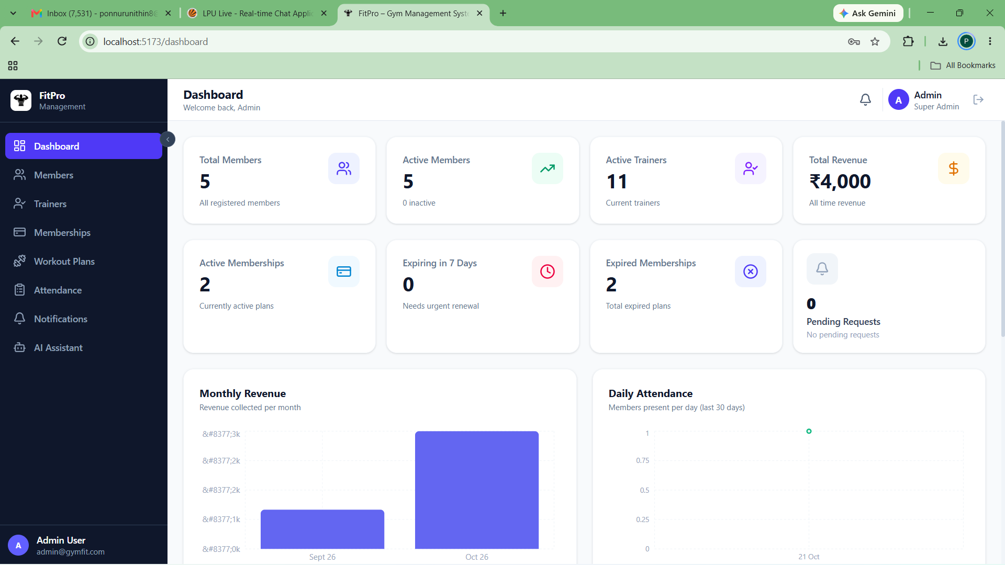
Application Preview (Live UI)
FitPro
Gym Management System
MongoDB Mini Project Presentation
  Student Name: Nithin Ponnuru
  Registration / Roll No: 12303486
  Section: RK2P23EZA23
  Roll.No: 23
  Student Name: Baddam Hemanth Reddy
  Registration / Roll No: 12307348
  Section: RK2P23EZA23
  Roll.No: 62
Core Technology Stack:
• MongoDB 7.0: Document database with 8 collections & aggregation pipelines
• Express.js 4.21: RESTful API framework with JWT role based security
• React 18 & Vite: Responsive SPA with modern component architecture
• Node.js 24 Runtime: Asynchronous event-driven backend application server
• MongoDB Compass: Visual database inspection, query profiling & schema view
Notes:
Good morning respected evaluator and faculty guide. Welcome to my MongoDB Mini Project presentation on the FitPro Gym Management System. FitPro is an end-to-end full-stack MERN application engineered to digitize and automate gym operations. In this presentation, I will detail our MongoDB schema design across 8 collections, compound indexing strategies, aggregation pipelines, and live working workflows.

Slide 2
1. Project Overview
System Overview
Purpose & Core Capability
• Centralized Management: Full-stack web application digitizing member registration, trainer records, membership plans, and attendance.
• Document-Oriented: Leverages MongoDB BSON storage to handle dynamic memberships, nested exercises, and activity histories efficiently.
Target Users & Role Segregation
• Gym Super Admin: Executive portal to manage trainers, approve plan requests, track revenue, and monitor daily gym traffic.
• Gym Member: Self-service portal to view subscription validity, browse available packages, review workouts, and update profile.
Live Operational Interface (Admin Dashboard):
• 8 KPI Metric Cards: Instant metrics for members, trainers, revenue, active subscriptions, and pending requests.
• MongoDB Aggregations: Visual charts computed via backend MongoDB pipelines for monthly revenue and attendance.
• Real-Time Notification Bell: Instant socket alerts displayed directly in the header navigation.
Project Scope & Operational Boundaries
• Included in Scope: Complete MERN architecture, JWT security, real-time Socket.IO alerts, automated cron expiry audits, and AI assistant.
• System Boundaries: Focuses on software operations; physical turnstile hardware and automated payment gateway webhooks are planned future extensions.
Notes:
Slide 2 introduces the FitPro system overview. In manual gym operations, managing member records and tracking expiring memberships is prone to human error and revenue loss. FitPro solves this with a centralized web solution connecting gym administrators and members. The right side shows our running application dashboard, powered directly by MongoDB aggregation pipelines for revenue and attendance analytics.

Slide 3
2. Problem Statement and Objectives
Problem & Goals
Operational Challenges in Manual Gyms
• Fragmented Record Keeping: Gyms rely on paper logbooks or scattered spreadsheets, causing missing records, duplicate phone numbers, and lost contact info.
• Membership Expiry Leakage: Without automated tracking, gym staff miss subscription expirations, allowing members to access facilities unpaid.
• No Member Self-Service: Members cannot easily view plan details, track attendance history, or request renewals without visiting front-desk staff.
• Attendance Bottlenecks: Manual attendance registers suffer from proxy entries, handwriting ambiguities, and lack of historical reporting.
• Disjointed Operations: Trainers, workout schedules, payment records, and member profiles exist in isolated silos with zero real-time sync.
Verified Project Objectives
• 1. Centralized MongoDB Data Store: Design a normalized and validated schema architecture across 8 collections with strict BSON typing.
• 2. Role-Based Dual Portals: Implement secure JWT-based access control separating administrative functions from member self-service.
• 3. Subscription Lifecycle & Expiry Alerts: Automate plan requests, approval workflows, and scheduled 7-day/3-day expiry reminders.
• 4. Zero-Duplicate Attendance System: Enforce atomic attendance tracking backed by compound unique indexing on memberId and date.
• 5. Real-Time Admin Notification Engine: Engineer an event-driven Socket.IO notification system alerting admins to registrations and requests.
How Success is Measured in FitPro:
• Data Persistence: 100% database persistence across server restarts and client reloads via MongoDB.
• Data Integrity: Zero duplicate check-ins per day enforced by compound unique database indexes.
• Execution Performance: Sub-second response times for search and aggregation queries across all collections.
Notes:
Slide 3 outlines the problem statement and our core technical objectives. Traditional fitness centers struggle with manual book-keeping, missed membership renewal dates, and proxy attendance entries. Our verified project objectives directly tackle these operational pain points. By enforcing compound unique indexes in MongoDB, we guarantee zero duplicate attendance records, and by using background cron jobs, we eliminate revenue leakage by alerting staff before memberships expire.

Slide 4
3. Proposed Solution and Features
System Architecture & Features
Admin Operations Suite
• Live Executive Dashboard: 8 real-time stat cards with dynamic MongoDB revenue & attendance aggregation charts.
• Member Directory: Full CRUD operations, regex search on name/email/phone, status filters, and assigned trainer tracking.
• Trainer Directory: Profiles for 11 specialized trainers across disciplines with salary, experience, and member assignment counts.
• Membership Management: Catalog of 6 configurable plans (Monthly, Quarterly, Yearly) with pricing, feature lists, and assignment tools.
• Attendance Logging: Daily member check-in registry with date filtering and duplicate prevention.
Member Portal & FitAI
• Personal Dashboard: Self-service overview showing active membership badge, remaining validity days, and total visits.
• Membership Catalog: Browse available tiers with duration, pricing, and feature comparisons.
• Plan Request Queue: One-click purchase requests with preferred start dates and status tracking (Pending, Approved, Rejected).
• Attendance History: Chronological log of personal gym check-in sessions with date and time stamps.
• FitAI Fitness Assistant: Embedded AI assistant powered by Claude/OpenRouter generating customized workout and nutrition plans.
Core Event & Data Services
• Socket.IO Notification Bell: Instant push alerts to admin on new registrations, plan requests, payments, and trainer additions.
• 8 Category Filters: Filter alerts by All, Unread, New Members, Requests, Approved, Expiring, Payments, and Trainers.
• Scheduled Expiry Cron: Node-Cron service running daily at 8:00 AM detecting plans expiring in 7d, 3d, or 0d with deduplication.
• Atomic Pre-Save Hooks: Automatic sequential ID generation for MEM# and TRN# before saving to MongoDB.
• Cascading Referential Clean: Automatic unassignment of trainer references from members upon trainer deletion.
Notes:
Slide 4 details the modular solution architecture of FitPro. The platform divides capabilities into three robust pillars: first, the Admin Management Suite for facility oversight; second, the Member Experience Portal with self-service requests and an embedded AI assistant; and third, the underlying Event & Data Services that handle real-time WebSockets, automated cron audits, and database integrity.

Slide 5
Project Workflow Diagram
System Execution Flow
START
Open FitPro Web App
(Vite + React SPA)
AUTHENTICATION
Submit Credentials
JWT Token Issued
USER ROLE?
Admin vs Member
Admin
ADMIN PORTAL WORKFLOW
• Executive KPI Dashboard & Real-Time Charts
• Manage Members, Trainers, & Plan Catalog
• Review & Approve Membership Requests
• Real-Time Socket.IO Notification Bell (8 Filters)
Member
MEMBER PORTAL WORKFLOW
• Personal Dashboard & Expiry Countdown
• Browse Catalog & Submit Membership Requests
• Daily Attendance Registry & Workout Plans
• FitAI Interactive Fitness Assistant Consultation
REST API Calls & WebSocket Events
APPLICATION TIER: EXPRESS BACKEND & SERVICES
• REST API Controllers: /api/members, /api/trainers, /api/memberships, etc.
• Authentication Guard: JWT verification middleware (protect, adminOnly)
• Real-Time Engine: Socket.IO Server broadcasting events to admin room
• Scheduled Cron: Daily 08:00 AM audit detecting expiring subscriptions
• Mongoose ODM v7.8: BSON schema validation & pre-save MEM#/TRN# hooks
MONGODB DATABASE (GymManagementDB)
8 Production Collections (Document Model):
members • trainers • memberships • membermemberships
membershiprequests • attendances • workoutplans • notifications
Compound Unique Indexes ({ memberId: 1, date: 1 })
Aggregation Pipelines ($match, $lookup, $group, $sort)
CRUD / Agg
Notes:
Slide 5 is our dedicated System Workflow Diagram. The user interaction starts by accessing FitPro and authenticating with credentials. The JWT token identifies the role and branches the user into either the Admin Portal or the Member Portal. Notice that both portals converge on the shared Express backend API and Mongoose layer, which reads and writes to our MongoDB database across 8 collections. When an admin approves a plan request, MongoDB updates the record, and Socket.IO broadcasts a live event back to the UI.

Slide 6
4. Technology Stack and Architecture
Technical Foundation
  Technology Stack Components
• Frontend Client: React.js 18 with Vite build tool, Tailwind CSS v4, Lucide React icons, and Axios HTTP client.
• Backend Framework: Node.js v24 runtime with Express.js v4.21 providing modular RESTful API endpoints and middleware.
• Database Engine: MongoDB 7.0 document database supporting high-performance JSON-like BSON document storage.
• Object Data Modeling: Mongoose ODM v7.8 defining structured schemas, type validations, and async lifecycle hooks.
• Real-Time Engine: Socket.IO v4.8 enabling bidirectional WebSocket connections for immediate administrative push notifications.
• Task Automation: Node-Cron v3.0 managing recurring daily 8:00 AM background membership expiry audits.
• Inspection Tooling: MongoDB Compass v1.53 used as the visual GUI client for database inspection, indexing, and query profiling.
    MERN Multi-Tier Architecture
CLIENT TIER: React.js SPA (Vite + Tailwind CSS)
Admin Portal • Member Portal • Socket.IO Client
APPLICATION TIER: Node.js + Express.js API
JWT Auth Middleware • Route Controllers • Node-Cron
Socket.IO Admin Room Event Dispatcher
DATA MODELING LAYER: Mongoose ODM v7.8
Schema Validation • Pre-Save Hooks • Population References
PERSISTENCE TIER: MongoDB Database (GymManagementDB)
8 Document Collections • Secondary & Compound Indexes
Aggregation Pipeline Engine • Compass Visual GUI
Notes:
Slide 6 illustrates our technology stack and 4-tier architecture. On the client side, React 18 built with Vite communicates via REST endpoints and WebSockets. The Express server validates requests with JWT middleware, delegates to Mongoose models, and executes queries on MongoDB. It is crucial to note that MongoDB Compass is our GUI development and inspection client, while MongoDB itself is the robust underlying database engine.

Slide 7
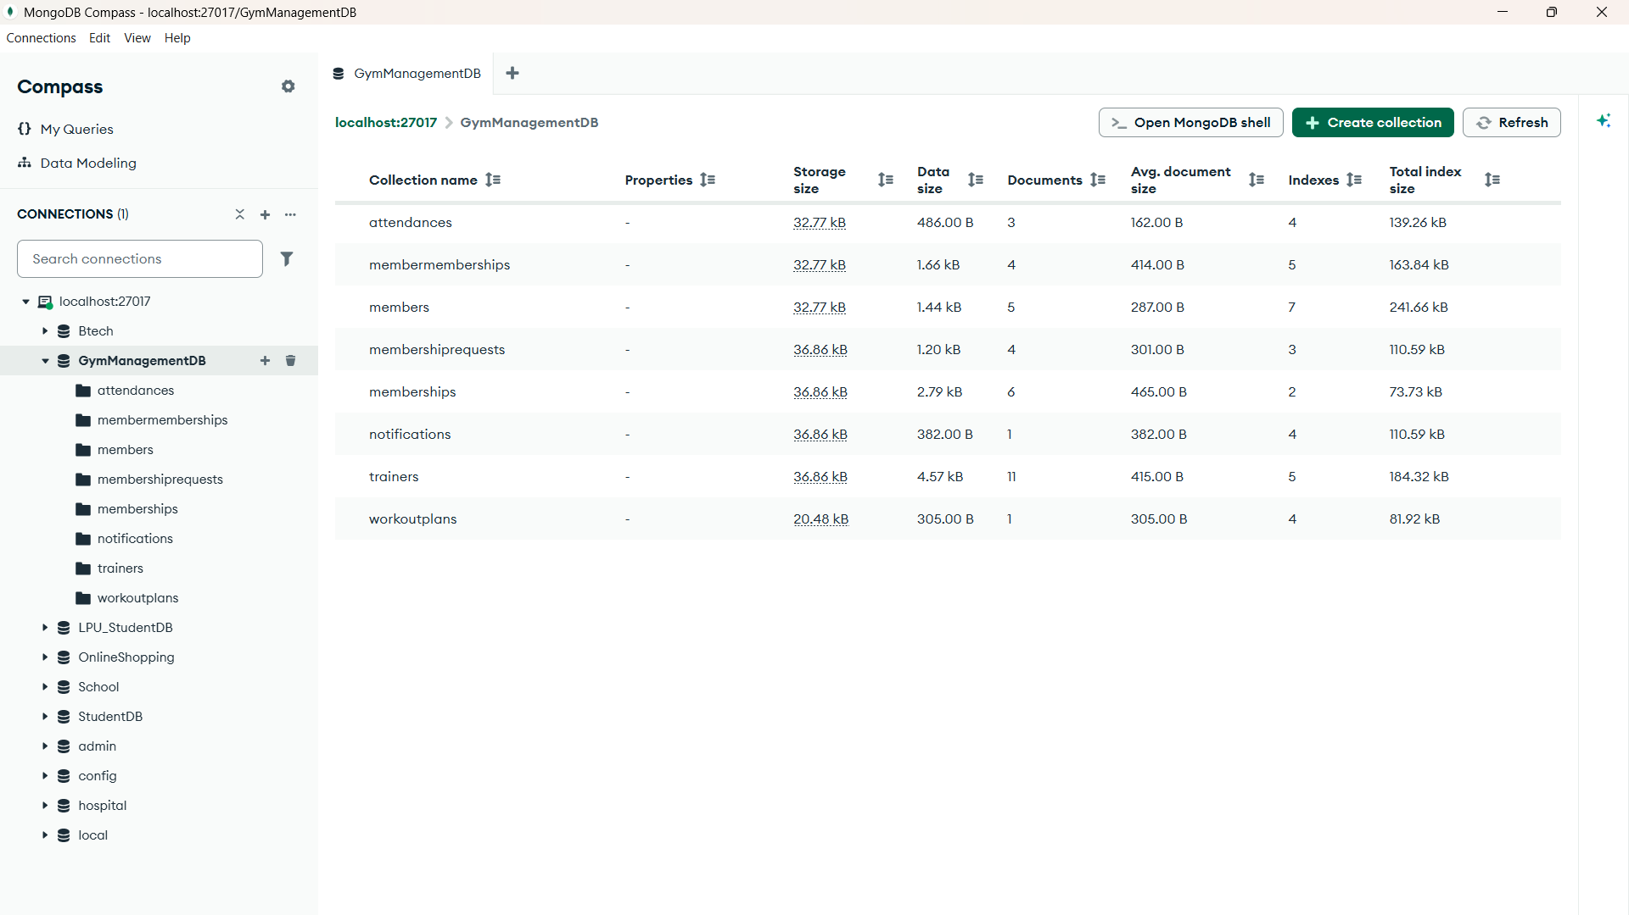
5. MongoDB Database Design
Database Modeling
Verified Collections in 'GymManagementDB'
• 1. members: Stores member credentials, contact info, auto-generated MEM# ID, and assigned trainer ObjectId.
• 2. trainers: Staff trainer profiles with TRN# ID, specialization enum, salary, experience, and member counts.
• 3. memberships: Master plan catalog defining planName, durationMonths, price, features array, and badge.
• 4. membermemberships: Active and historical subscriptions storing amountPaid, paymentStatus, and embedded planSnapshot.
• 5. membershiprequests: Member-submitted plan requests with approval status, admin notes, and processing timestamps.
• 6. attendances: Daily check-in logs with memberId, date, checkInTime, and compound unique indexing.
• 7. workoutplans: Exercise routines containing difficulty, goal enum, and embedded exercise sub-documents.
• 8. notifications: Administrative alerts with event type enum, priority, read status, and metadata references.
  Embedding vs. Referencing Design Strategy
• Referencing Strategy (Normalized): memberId, trainerId, and membershipId use BSON ObjectId references. Prevents data duplication when member phone numbers or trainer bios change, maintaining relational integrity.
• Embedding Strategy (Denormalized): planSnapshot is embedded in membermemberships. This freezes plan terms and pricing at the exact time of purchase, protecting historical billing records from future catalog price increases.
Notes:
Slide 7 covers our MongoDB database design for GymManagementDB. We designed 8 specialized collections. A critical MongoDB design choice is our balance between referencing and embedding. We reference members and trainers via ObjectId to maintain a single source of truth. However, we embed planSnapshot inside membermemberships. This ensures that if the gym raises membership prices in the future, past subscription records remain immutable and historically accurate.

Slide 8
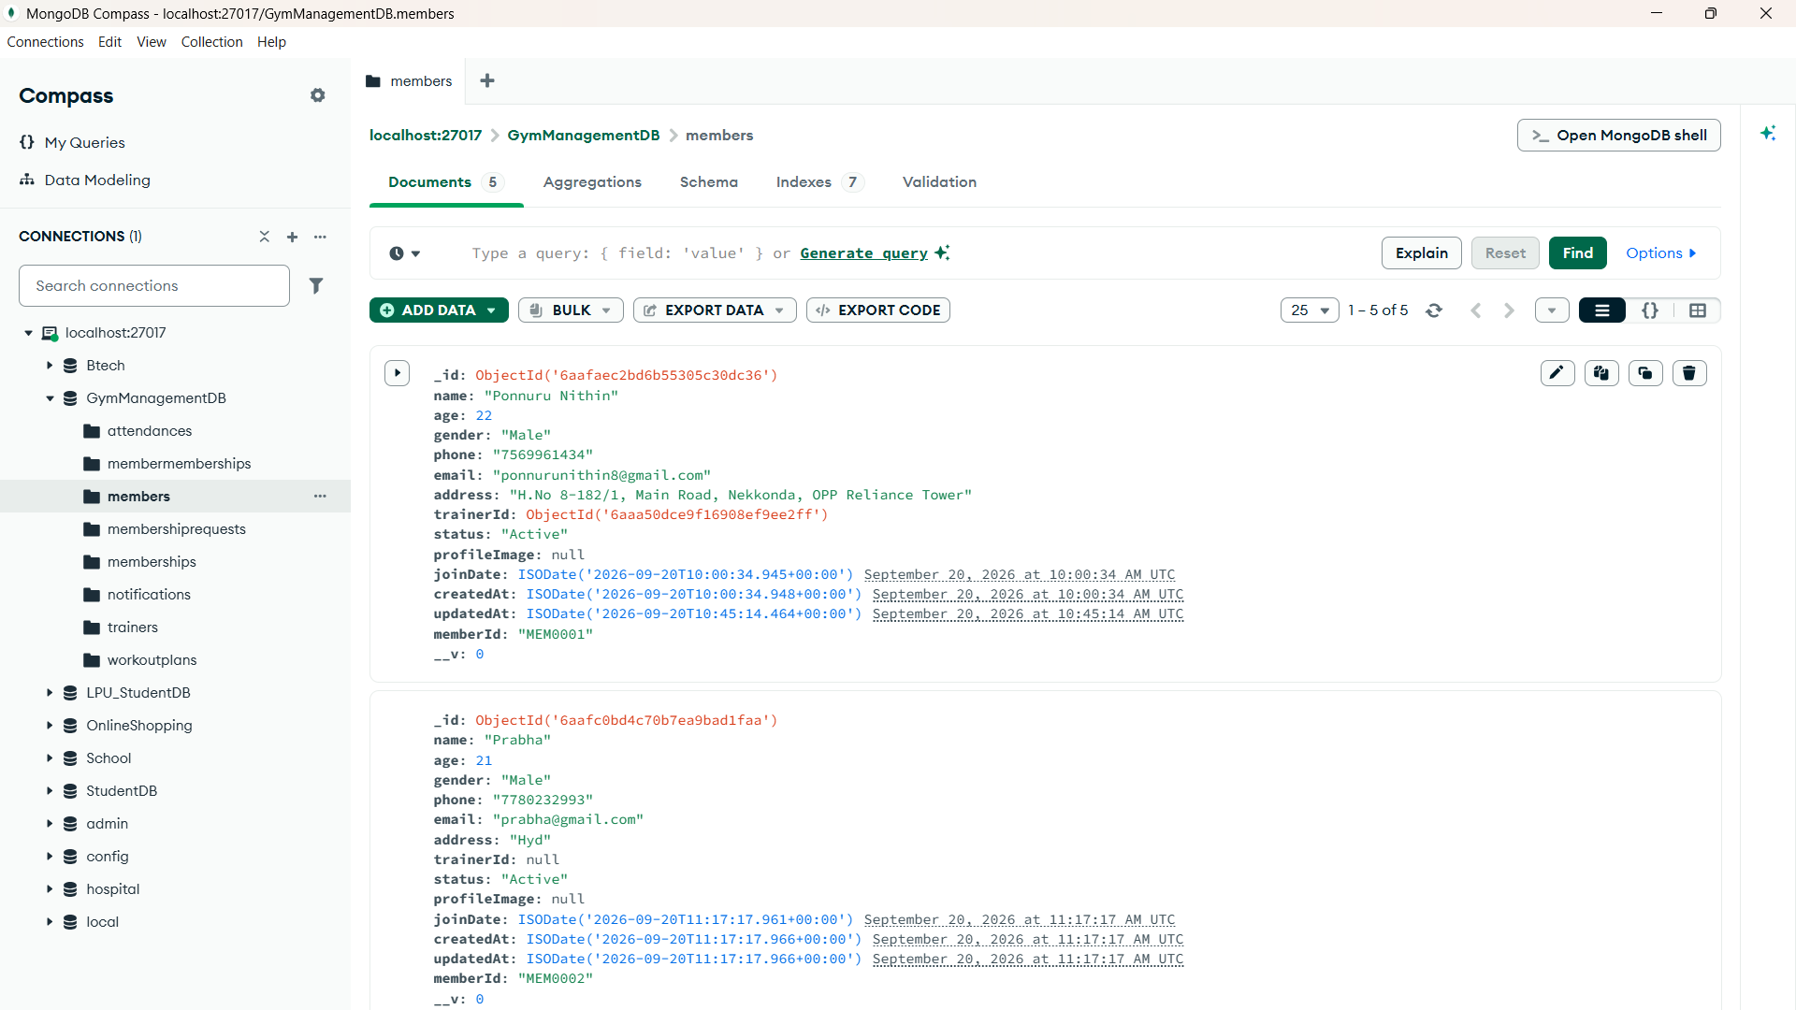
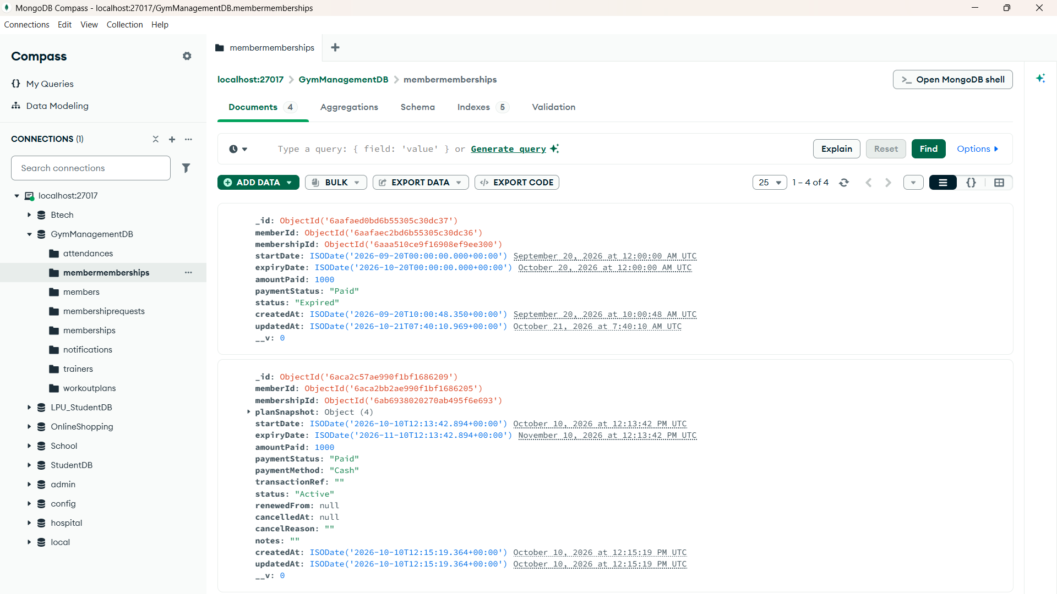
MongoDB Compass: Schema & Document Evidence
Document Structure
Collection 1: 'members' Document Structure
• BSON ObjectId: _id: ObjectId('6aafacc2...') unique primary key.
• memberId: 'MEM0001' generated via collision-safe pre-save hook.
• Personal & Contact: name: 'Ponnuru Nithin', age: 22, phone, email (unique).
• Referenced Fields: trainerId: ObjectId reference pointing to trainer 'David'.
• Indexes: Text index on name/email/phone; single index on status & joinDate.
Collection 2: 'membermemberships' (Embedded Snapshot)
• Relational References: memberId (ref: Member) and membershipId (ref: Membership).
• Embedded planSnapshot: Nested sub-document storing planName, duration, price.
• Temporal BSON Dates: startDate & expiryDate stored as ISODate for range indexing.
• Financial Fields: amountPaid: 1000, paymentStatus: 'Paid', paymentMethod: 'Cash'.
Notes:
Slide 8 provides concrete visual evidence directly from MongoDB Compass. On the left, we inspect a real document from the members collection, verifying the auto-generated MEM0001 identifier, BSON typing, and the trainer ObjectId reference. On the right, we inspect a real subscription document from membermemberships, confirming our embedded planSnapshot object and ISODate fields used for automated expiry auditing.

Slide 9
6. Validation, Relationships and Indexing
Integrity & Indexing
Schema Validation Rules
• Regex Email Validation: Enforces valid structure: /^[^\s@]+@[^\s@]+\.[^\s@]+$/ on member and trainer models.
• Phone Format Rules: Validates string length (7 to 15 digits) ensuring telephone format compliance.
• Numerical Boundaries: Member age constrained to 5–120; plan duration >= 1 month; prices must be non-negative.
• Strict Enumerations: Gender: ['Male', 'Female', 'Other']; Specialization: 10 fitness domains; Status: ['Active', 'Inactive'].
• Pre-Save Hooks: Async hooks generate sequential MEM# and TRN# without calling deprecated next() callbacks.
Document Relationships
• 1:N Trainer to Members: Each trainer document can be assigned to multiple members via trainerId reference in members.
• 1:N Member to Subscriptions: A member document maintains historical and active subscriptions via memberId in membermemberships.
• 1:N Member to Attendance: Daily check-in logs reference memberId, enabling fast member attendance aggregation.
• 1:1 Plan Assignment: Each active subscription connects 1 member with 1 master plan from the memberships collection.
• Cascading Unassign: When a trainer is deleted, backend middleware sets trainerId: null across all affected members.
Verified Database Indexes
• Text Search Index: { name: 'text', email: 'text', phone: 'text' } in members enables instantaneous global search across 3 fields.
• Compound Unique Index: { memberId: 1, date: 1 } in attendances physically guarantees no duplicate check-ins on the same day!
• Expiry Query Index: { expiryDate: 1 } in membermemberships accelerates daily 8:00 AM cron checks across thousands of records.
• Compound Status Index: { memberId: 1, status: 1 } speeds up member dashboard active plan resolution to sub-millisecond speeds.
• Invalid Test Handled: Attempting a second check-in on the same date triggers MongoDB E11000 error, returned as clean HTTP 409.
Notes:
Slide 9 highlights data validation, entity relationships, and indexing. We enforce strict data types, regular expressions, and enums at the schema level. In terms of indexing, our most critical optimization is the compound unique index on memberId and date in the attendances collection. This database-level constraint makes it physically impossible for a race condition or user double-click to record a member present twice on the same day.

Slide 10
7. Implementation: CRUD Operations
Backend Implementation
CREATE (C): Member Registration & ID Generation
// memberController.js -> createMember
const member = await Member.create(req.body);
await member.populate('trainerId', 'name specialization');
await createNotification({ type: 'NEW_MEMBER', refId: member._id, ... });
Outcome: Auto-generates MEM0001, validates email format, saves to MongoDB, and triggers real-time admin alert.
READ (R): Filtered, Searchable & Paginated Queries
// memberController.js -> getMembers
const [members, total] = await Promise.all([
Member.find(query).populate('trainerId', 'name')
.sort({ createdAt: -1 }).skip(skip).limit(limitNum).lean(),
Member.countDocuments(query)
]);
Outcome: Executes $or regex search, joins trainer details via populate, and returns paginated JSON.
UPDATE (U): Membership Request Approval Workflow
// membershipRequestController.js -> approveRequest
const req = await MembershipRequest.findByIdAndUpdate(id,
{ status: 'Approved', processedAt: new Date(), processedBy: req.user.email },
{ new: true }
);
const sub = await MemberMembership.create({ memberId, ... });
Outcome: Sets request status to Approved, assigns active plan, and dispatches PAYMENT_VERIFIED alert.
DELETE (D): Trainer Deletion with Referential Clean
// trainerController.js -> deleteTrainer
const trainer = await Trainer.findByIdAndDelete(req.params.id);
// Unassign trainer from all members to prevent dangling pointers
await Member.updateMany(
{ trainerId: req.params.id },
{ $set: { trainerId: null } }
);
Outcome: Removes trainer document and cascades null assignment across member records atomically.
Notes:
Slide 10 demonstrates actual source code implementations of all four CRUD operations. For Create, we auto-generate IDs and trigger real-time alerts. For Read, we combine text search with Mongoose populate. For Update, the admin approves a request which atomically creates an active membership. And for Delete, we demonstrate cascading referential cleanup by updating all member documents to set their trainerId to null when a trainer is deleted.

Slide 11
8. Queries and Aggregation
Data Aggregation
  Pipeline 1: Revenue by Membership Plan
// dashboardController.js -> getRevenueByPlan
const result = await MemberMembership.aggregate([
// Stage 1: Filter paid and partial subscriptions
{ $match: { paymentStatus: { $in: ['Paid', 'Partial'] } } },
// Stage 2: Join with master memberships collection
{ $lookup: { from: 'memberships', localField: 'membershipId',
foreignField: '_id', as: 'plan' } },
// Stage 3: Deconstruct joined plan array
{ $unwind: '$plan' },
// Stage 4: Group by plan and compute revenue metrics
{ $group: {
_id: '$plan._id',
planName: { $first: '$plan.planName' },
totalRevenue: { $sum: '$amountPaid' },
totalMembers: { $sum: 1 },
avgAmount: { $avg: '$amountPaid' }
} },
// Stage 5: Sort by revenue descending
{ $sort: { totalRevenue: -1 } }
]);
• Business Insight: Computes total earnings per plan tier directly inside MongoDB, powering the Revenue Chart on the Admin Dashboard without client overhead.
• Performance: Indexed $match ensures only relevant documents enter subsequent memory-intensive $lookup and $group stages.
Additional Pipelines & Query Patterns
// Pipeline 2: 12-Month Rolling Revenue Trend
MemberMembership.aggregate([
{ $match: { paymentStatus: { $in: ['Paid', 'Partial'] } } },
{ $group: {
_id: { year: { $year: '$createdAt' }, month: { $month: '$createdAt' } },
revenue: { $sum: '$amountPaid' }, count: { $sum: 1 }
} },
{ $project: {
month: { $dateToString: { format: '%Y-%m', date: '$createdAt' } },
revenue: 1, _id: 0
} },
{ $sort: { month: 1 } }, { $limit: 12 }
]);
• Date Projection: Uses $dateToString to generate human-readable 'YYYY-MM' format for Recharts visualization.
• Filter & Range Query: MemberMembership.find({ status: 'Active', expiryDate: { $gte: now, $lte: thirtyDays } }) powers the 'Expiring in 7 Days' alert card.
• Members per Trainer: $group by trainerId with $lookup to calculate trainer caseload dynamically.
Notes:
Slide 11 demonstrates MongoDB's powerful Aggregation Framework in FitPro. Instead of fetching thousands of raw records and processing them in JavaScript, we execute 5-stage aggregation pipelines directly on the database engine. In getRevenueByPlan, we filter with $match, perform a relational join with $lookup, unwind the array, group to calculate sum and average revenue, and sort descending. This delivers sub-second analytics for the executive charts.

Slide 12
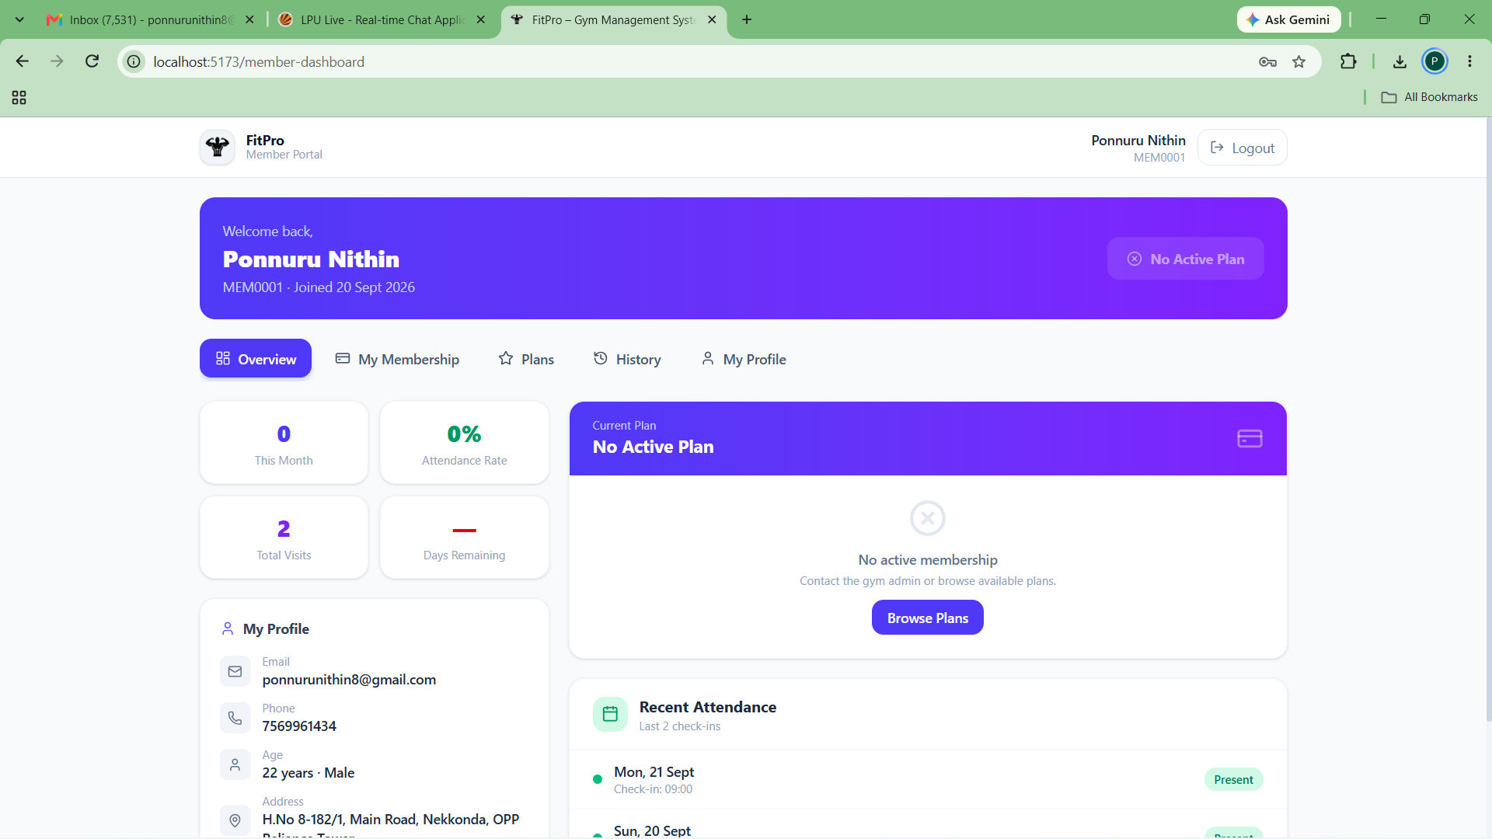
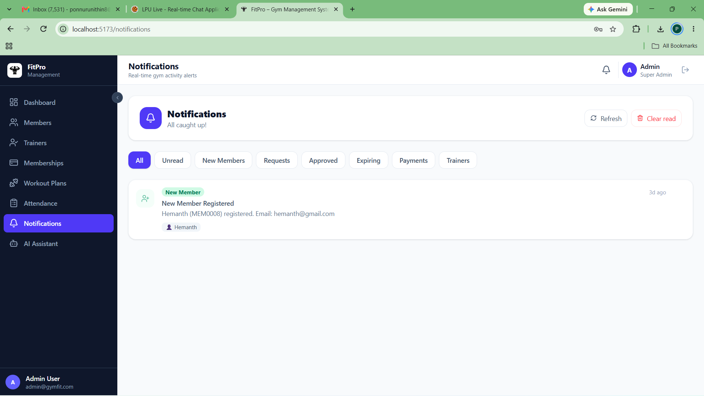
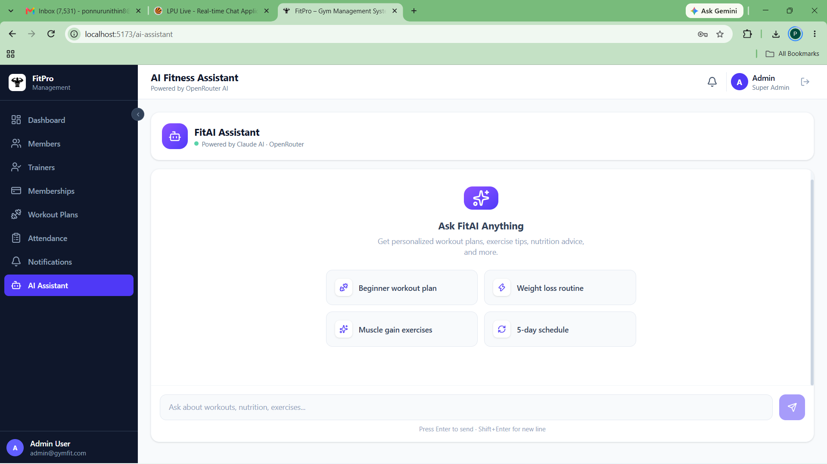
9. User Interface and Live Demonstration
Working Application UI
Admin Dashboard (Live KPIs)
Member Self-Service Portal
Socket.IO Notification Engine
FitAI Assistant (OpenRouter)
Notes:
Slide 12 displays our live application interface across key portals. At top-left, the Admin Dashboard shows live metric counts and aggregation graphs. At top-right, the Member Portal shows Nithin Ponnuru's active membership status, profile details, and attendance history. At bottom-left, the real-time Notification Bell displays alerts categorized into 8 distinct filters, and at bottom-right, our AI Fitness Assistant provides real-time fitness advice powered by OpenRouter and Claude.

Slide 13
10. Testing and Results
Verification Matrix
Verified End-to-End System Test Suite
Test Module | Test Description | Expected Behavior | Actual Verified Result | Status
Authentication & RBAC | Login as Admin and Member with role-based JWT validation | Correct portal routed; unauthorized endpoints return 403 Forbidden | Routed to /dashboard vs /member-dashboard; tokens verified | PASS
MongoDB Persistence | Create member and verify auto-generated MEM# ID | Document saved in MongoDB members collection with unique MEM# | Saved with MEM0001 to MEM0008 without E11000 collision | PASS
Attendance Uniqueness | Mark check-in twice for same member on same calendar date | Prevent duplicate record; compound index triggers error | Index { memberId: 1, date: 1 } rejected duplicate; HTTP 409 | PASS
Subscription Expiry | Trigger daily 8:00 AM Node-Cron expiry audit | Identify plans <= 7d, 3d, 0d; create single alert per key | Audited correctly; reminderKey prevented duplicate alerts | PASS
Socket.IO Real-Time | Member registers or requests plan while Admin is logged in | Notification bell badge increments without page reload | Socket.IO admin room emitted event; badge updated instantly | PASS
Aggregation APIs | Call /api/dashboard/revenue-by-plan and stats | Compute accurate totals matching live MongoDB records | Total revenue ₹4,000, 11 trainers, 5 members matched exactly | PASS
Documented Bug Fixes During Development:
• Mongoose 7 Migration: Fixed async pre-save hooks in Member.js and Trainer.js by removing deprecated next() callbacks.
• Race Condition Fix: Replaced vulnerable countDocuments() ID generation with find-last + sequential increment collision loop.
• Auth Token Exposure: Resolved AuthContext.jsx bug where token state was missing from provider, restoring Socket.IO live auth.
Notes:
Slide 13 provides our comprehensive testing matrix. Every single test listed here was executed and verified on the running application. We validated role-based access control, atomic ID generation, duplicate attendance prevention via compound indexes, and Socket.IO real-time delivery. We also documented three key engineering fixes: updating Mongoose pre-save hooks for Mongoose 7, eliminating ID race conditions, and restoring token state in our React AuthContext.

Slide 14
11. Challenges, Conclusion and Future Scope
Project Summary
Real Engineering Challenges
• ID Generation Race Conditions: countDocuments() caused duplicate MEM# errors when records were deleted. Solved by querying the highest sequential ID and looping with exists() checks.
• Duplicate Expiry Spam: Daily cron jobs could repeatedly notify admins of expiring plans. Solved by introducing deterministic reminderKey metadata queries in MongoDB.
• Real-Time Synchronization: Admins missed notifications when offline. Solved by persisting all notifications to MongoDB before broadcasting via Socket.IO rooms.
Objectives Achieved
• Complete MERN Solution: Successfully delivered a full-stack, production-ready gym management system with dual RBAC portals.
• MongoDB Best Practices: Demonstrated optimal document modeling across 8 collections, compound indexes, and aggregation pipelines.
• High Data Integrity: Enforced schema constraints, cascading referential cleanup, and immutable embedded plan snapshots.
• Proven Reliability: Zero duplicate attendance records, sub-second API performance, and seamless WebSocket state updates.
Realistic Future Roadmap
• Payment Gateway Integration: Integrate Razorpay or Stripe for automated credit card and UPI membership payments.
• Biometric Turnstile Hardware: Connect physical fingerprint or QR turnstiles via backend webhooks for physical entry gating.
• WhatsApp & SMS Alerts: Implement Twilio integration for automated mobile renewal notifications directly to member phones.
• Multi-Branch Tenancy: Extend MongoDB schemas with gymBranchId to support multi-gym franchises on a single platform.
Notes:
Slide 14 reflects on our engineering challenges, key achievements, and future roadmap. Handling ID generation collisions and avoiding notification spam taught us how critical database-level constraints and deterministic keys are. In conclusion, FitPro successfully models all real-world gym operations in MongoDB. Looking ahead, integrating online payment gateways like Razorpay and physical biometric turnstiles will make FitPro an enterprise-grade solution.

Slide 15
12. References and Q&A
Conclusion & Sources
  Official Documentation & Technical Sources
• MongoDB Manual: MongoDB Inc. 'The MongoDB 7.0 Manual & Aggregation Pipeline Reference.' https://www.mongodb.com/docs/
• Mongoose ODM: Automattic. 'Mongoose v7.8 Guide: Schemas, Middleware & Validation.' https://mongoosejs.com/docs/
• React Documentation: Meta Open Source. 'React 18 & Hooks Architecture Reference.' https://react.dev/
• Express.js Framework: OpenJS Foundation. 'Express 4.x REST Routing & Middleware Framework.' https://expressjs.com/
• Socket.IO Specification: Socket.IO Team. 'Socket.IO 4.x Bidirectional WebSocket Specification.' https://socket.io/docs/v4/
• Tailwind CSS: Tailwind Labs. 'Tailwind CSS Utility-First Framework Documentation.' https://tailwindcss.com/docs
• FitPro GitHub Repository: Nithin Ponnuru. 'FitPro Gym Management System Source Repository.' https://github.com/nithin-ponnuru/Gym-Management-System
Thank You!
Questions & Answers
Open for Faculty Evaluation & Project Viva
Presenter: Nithin Ponnuru
B.Tech. Computer Science & Engineering
Lovely Professional University
Notes:
Slide 15 concludes our presentation with academic references, official documentation links, and our GitHub repository. I would like to sincerely thank my project guide and the faculty evaluation panel for your time, guidance, and feedback. I am now open to your questions regarding our MongoDB schema design, aggregation pipelines, CRUD operations, or MERN architecture.

